Slide 1
New NA-ion cells to accelerate the European Energy Transition
NA ION MATERIALS AS ESSENTIAL COMPONENTS TO MANUFACTURE
ROBUST BATTERY CELLS FOR NON-AUTOMOTIVE APPLICATIONS

Slide 2
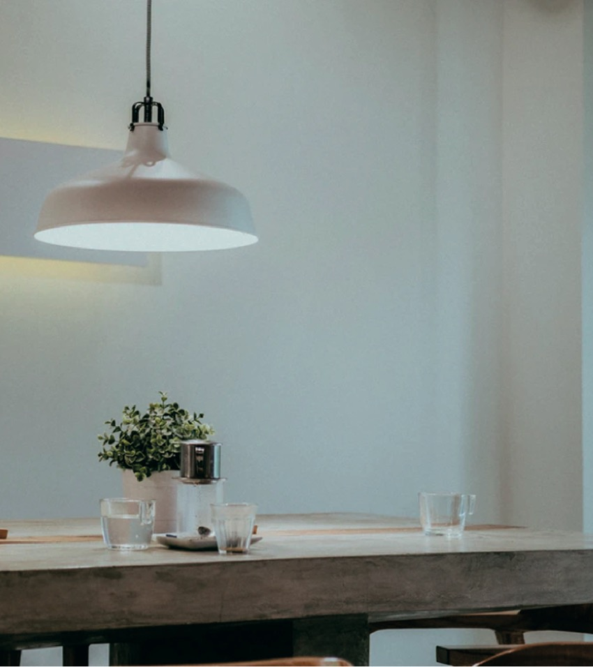
What NAIMA is?
NAIMA project is a European project designed to develop and validate a new generation of Sodium-ion (Na-ion) based batteries to unseat the current Li-based technologies.
The European Union is transitioning to a secure, sustainable and competitive energy system based on renewable sources. The flourishing of a wide portfolio of renewable energy installations is allowing the deployment of large to small scale industrial electricity grids, and an increased share of electricity produced in private households.
In these business scenarios the role of the energy storage techonologies is crucial.
At present, the European industry depends on the import of Asian Lithium-ion batteries. For this reason, it is crucial to create a new industry value chain capable to ensure the production and supply of 100% European batteries.
The NA-ion technology is already supported by a solid European battery value chain, preserving the ownership and industry strength around European countries
With an overall budget of 8 million euros funded by the European Commission through the Horizon 2020 programme, NAIMA, which began on 1st of December 2019, will gather 15 partners working together until November 30th, 2022.

Slide 3
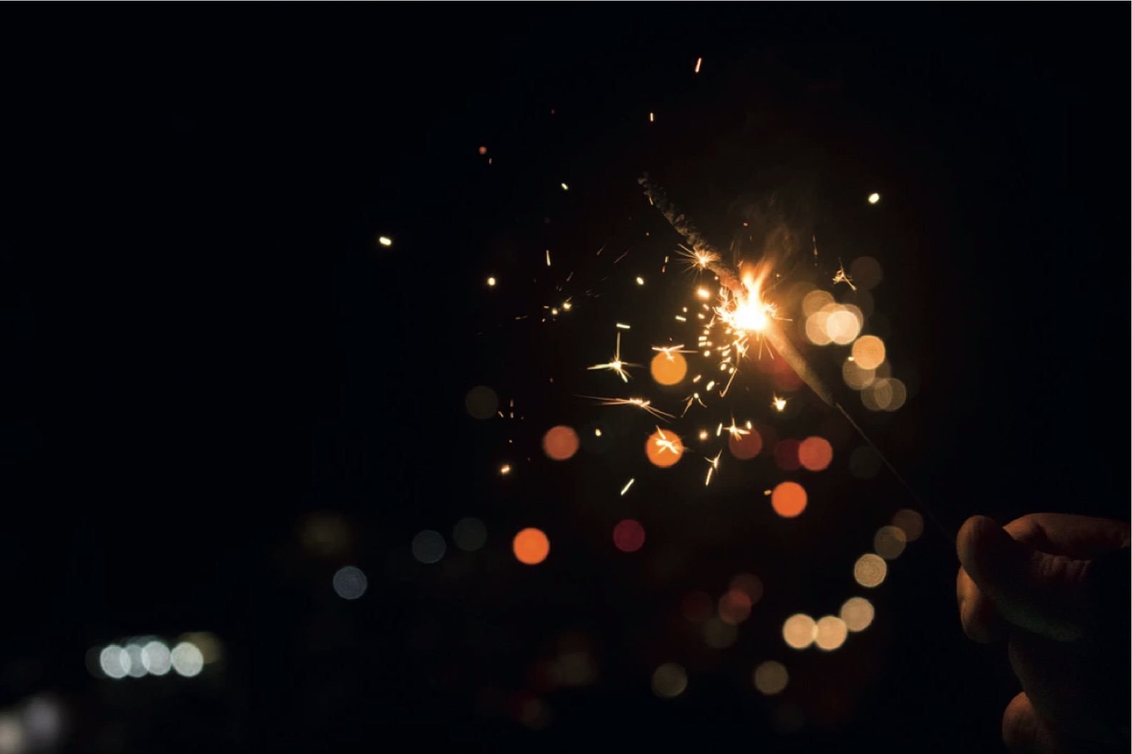
The NA-ion Cell Concept

Slide 4
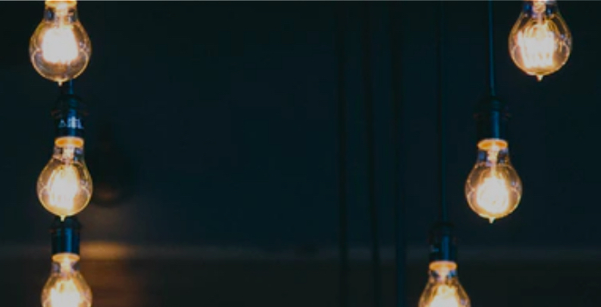
The Na-ion Cell Concept
The NAIMA project is conceived to develop and test 2 configurations of enhanced Na-ion cells to satisfy the main energy storage system applications demanded by the end-users of the stationary energy sector.

Slide 5
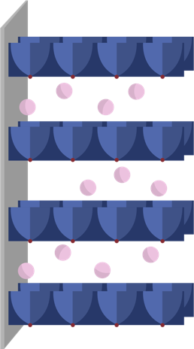
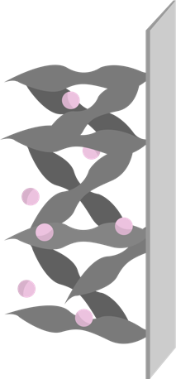
The Na-ion Cell Concept
This novel concept becomes a reality configured in the following 2 cell designs:
1) High power and fast charge design concept
(120Wh/kg; 250Wh/l; 5000W/kg; 8,000 cycles; >50% recycling rate; 0.05€/kWh/cycle and ++Safety)
2) Low cost and energy design concept
(200Wh/kg; 420Wh/l; 500W/kg; 6,000 cycles; >50% recycling rate; 0.04€/kWh/cycle and ++Safety)
Electrolyte
Negative electrode – Anode
Positive electrode – Cathode

Slide 6
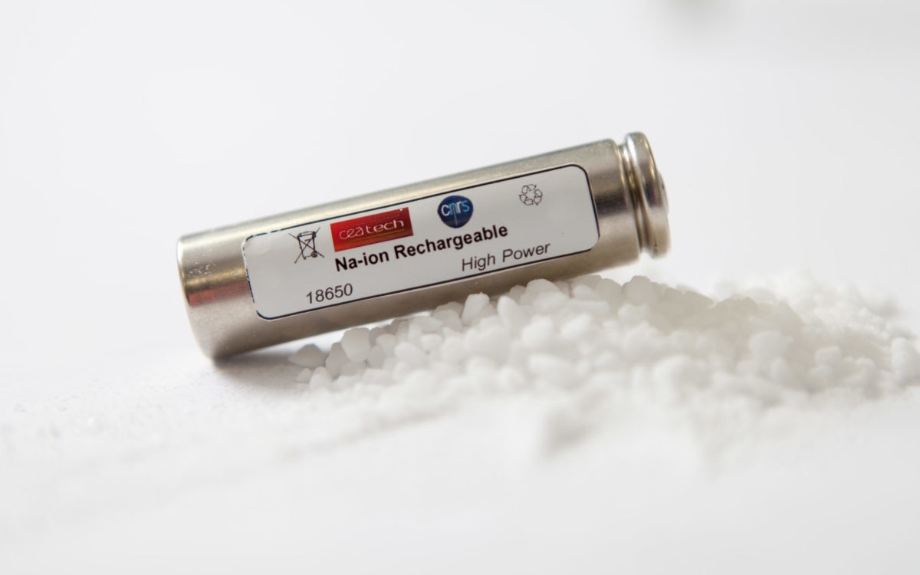
The NAIMA specific goals

Slide 7
Specific goals
1.- To develop and test 2 enhanced configurations of Na-ion cells conceived by the perfect combination of novel advanced materials and chemistries, to demonstrate the fulfilment of KPIs directly linked with the technological competitiveness of the technology.
In order to achieve the main NAIMA goal, to develop a new generation of high-competitive and safe Na-Ion battery cells for a more competitive European Industry, the project has identified 8 specific goals.
2.- To apply a set of cost reduction strategies to pave the way towards a high competitiveness with the aim of reaching a cost target of 0.05€/kWh0.05€/kWh/cycle and 0.04€/kWh/cycle by the end of the project.

Slide 8
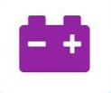
Specific goals
3.- To design, assembly and test 6 Sodium-ion batteries (SIB) prototypes as a full system, in 3 different Business Scenarios where the role of storage technologies is considered vital for the end-users.
4.- To introduce novel strategies such as eco-design, circular economy, high recycling and 2nd life applications to guarantee the development of a sustainable SIB and to demonstrate its environmental, social and economic impact by the development of a full low cost cell design and high power cell design for industry application.

Slide 9
Specific goals
5.- To contribute the creation of a new EU battery industry by the commitment of investments in manufacturing plants, especially in the component production and cell assembly stages of the SIB value chain, reducing the EU dependence of the raw materials for Li-ion batteries.
6.- To create a detailed technology development roadmap to establish the product development strategies required to achieve the target KPIs by 2030:
-200 Wh/kg (gravimetric energy density)
-1,500 W/kg (gravimetric specific power)
-> 750 Wh/l (Volumetric energy density)
-10,000 cycles and >50% recycling rate

Slide 10
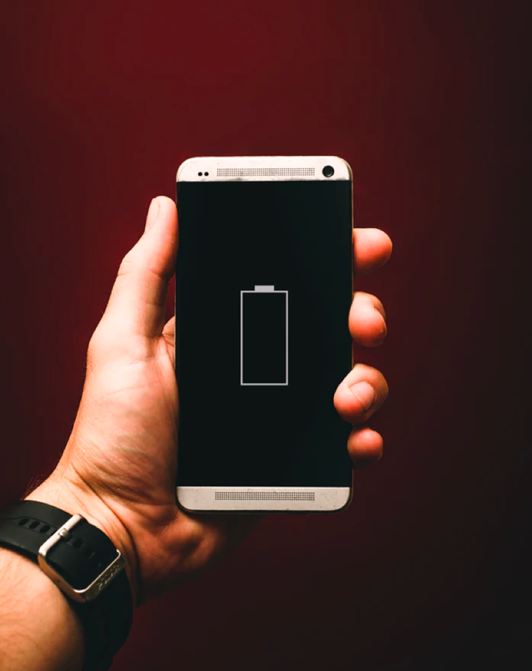
Specific goals
7.- To create an industry upscaling roadmap enabling the strengthening of the European Battery Industry by addressing the whole value chain.
8.- To establish the main pillars of a precise refined feasibility study and business plan as a strategic tool to get a smooth market penetration and proper orientation of the future products and services in 2023.

Slide 11
Management Structure

Slide 12
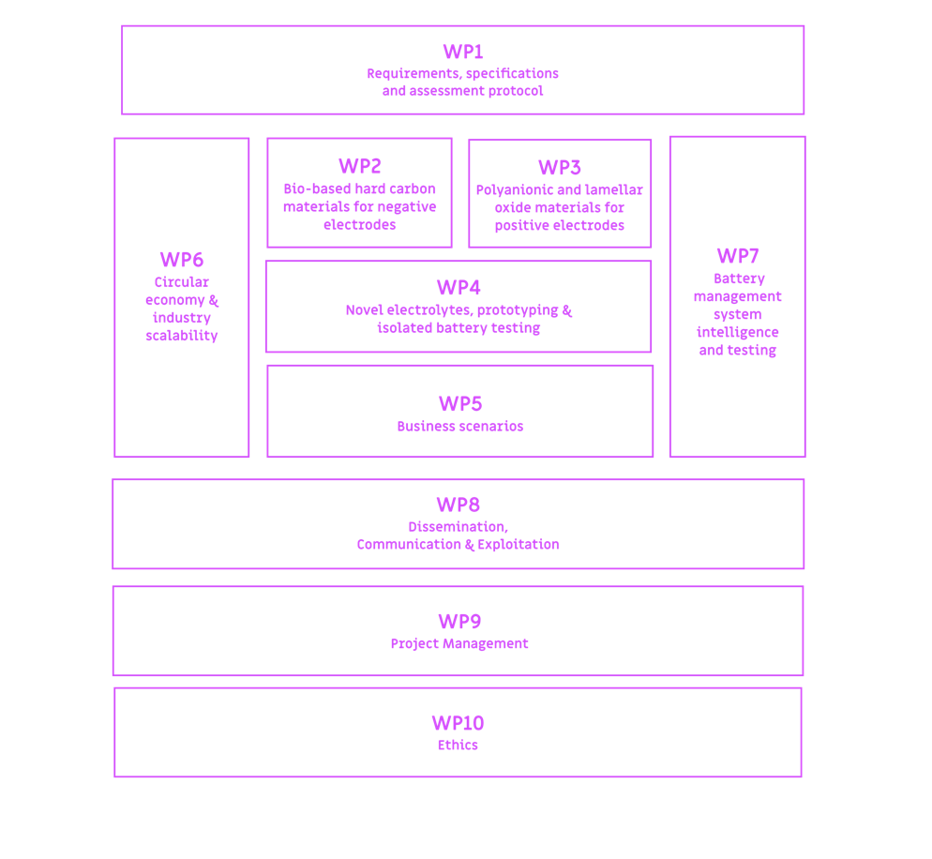
The Work Packages
NAIMA project applies a holistic methodology structured around 10 interrelated work packages (WP), leading to achieve the initiative’s specific objectives.

Slide 13
Business Scenarios

Slide 14
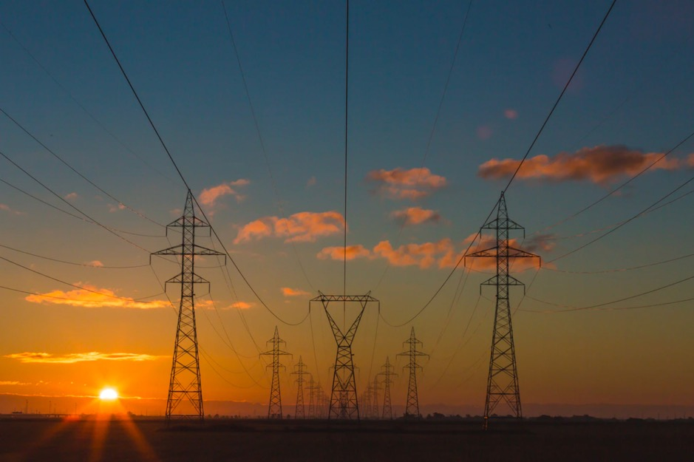
Business Scenarios
NAIMA will provide solid evidences about the competitiveness of the new technology in 3 energy storage system environments through the application of an assessment and monitoring protocol that will be tested in 3 multi-scale Business Scenarios (BS).

Slide 15
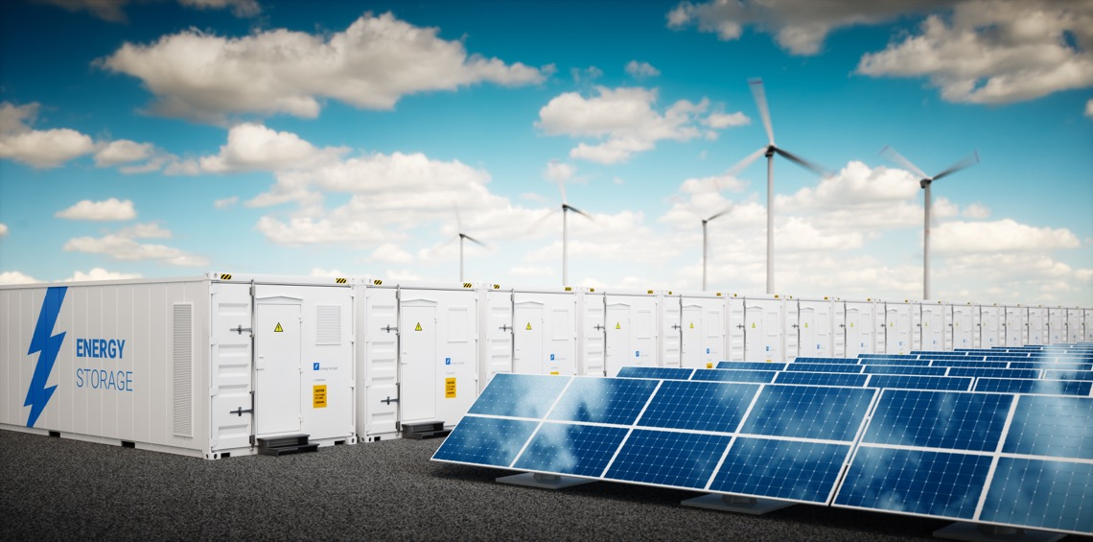
Renewable Generation Application
GREEN SIB prototype dedicated to renewable generation will be tested in the EDFlab Les Renardieres, located in Écuelles (France).
The prototype will be tested in lab using a DC system and simulating the use in a real system. The prototype performance will be simulated, and the calculated solicitation profile will be applied to the system.
According to its performance and specification the Na-ion technology could be a very good challenger for renewable generation use-case. Thanks to its power capabilities, lifetime and eco-friendly raw materials Na-ion could be easily scaled up (with the same production factories than LiB) and could advantageously be installed in renewable storage facilities.

Slide 16
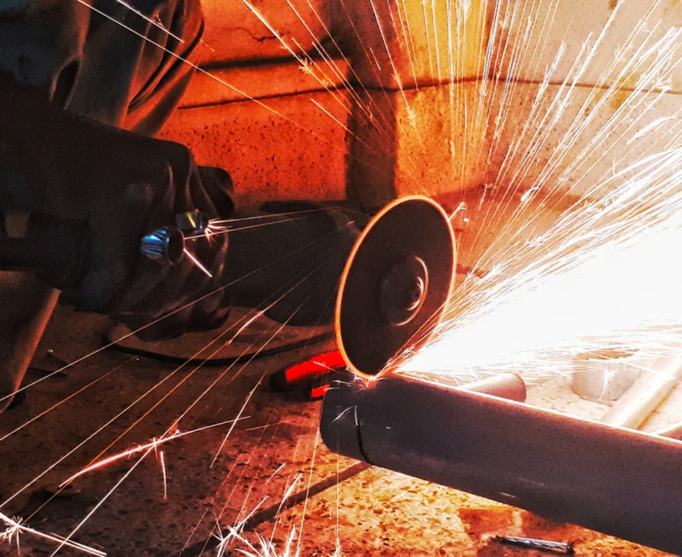
Industry Scenario
Blue SIB prototype for industrial applications will be tested in two different factories of Gestamp, located in Navarra (Spain).
Industrial production is a crucial pillar of the European economy and remains a key driver for economic growth and job creation. At present, industry is experiencing the Fourth Industrial Revolution known as Industry 4.0. This new paradigm has its own challenges and require efficient and safe powering.
In this context, NAIMA solution, capable of handling high charging current and to deliver high currents, will suit to the industry needs in terms of power supply.
To validate the application for industry, the industrial components manufacturer Gestamp will be in charge of testing two units of the Blue SIB prototype in two different plants of the company.

Slide 17
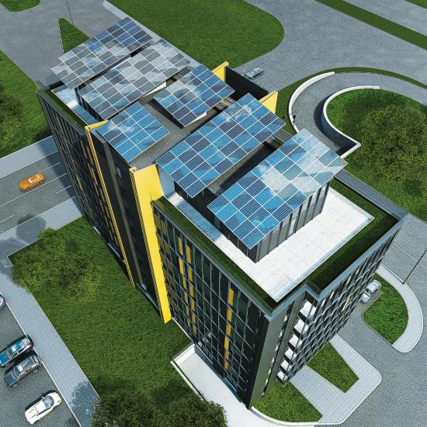
Private Household Scenario
The Yellow SIB prototype, aimed to private households, will be tested in Sofia (Bulgaria)
NAIMA Project will enable a specific solution for households based on the lamellar oxide families as this family focuses on low-cost materials that can cycle thousands of cycles, a feature that has been seldom demonstrated so far.
Goldline partner will provide a demo site for the two units of SIB prototypes addressed to household BS. The site will consist of an office building with a roof-top with PV panels and storage units, while there is a private transformer and independent interconnections with the distribution grid.

Slide 18
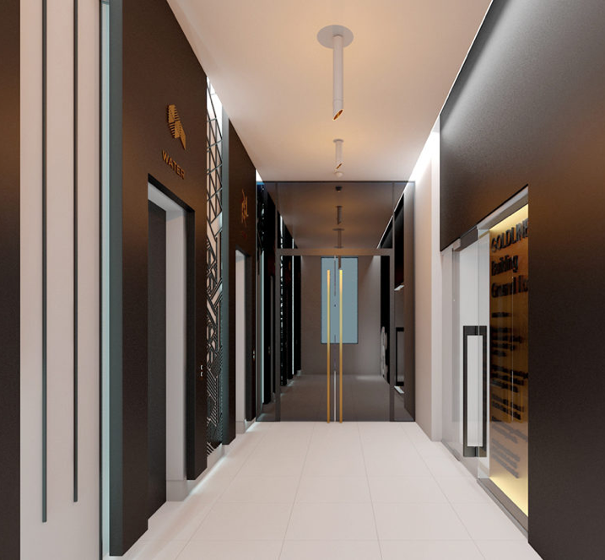
Private Household Scenario
The building also has EV charging stations, energy efficient elevators, LED lighting and HVAC. Some of the innovative features of the building are:
Reliable top-level elevators
Natural light, active sunshades and adaptive LED lighting
Stimulation of the use of environmentally friendly vehicles.
Care for the most valuable natural resource – water.
Modern monitoring practices and analysis of energy consumption.

Slide 19
Consortium

Slide 20
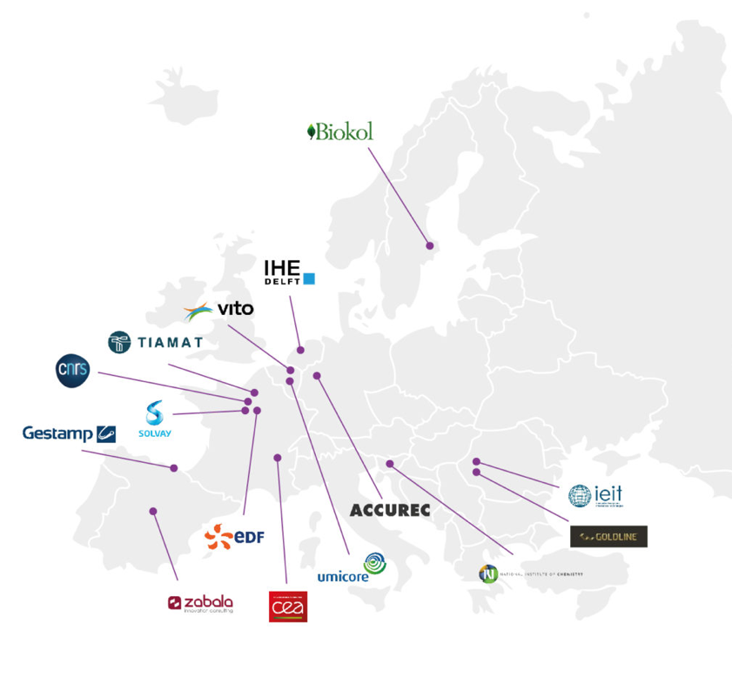
Who will make NAIMA possible?
NAIMA brings together a strong and complementary consortium, including 15 partners from 7 European countries.
The interdisciplinary profiles of the partners offer an appropriate balance covering the entire value chain and diverse fields required in the project.

Slide 21
New Na-ion cells to accelerate the European Energy Transition

Slide 22
April 2020

